Slide 1
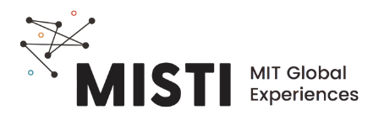
Local Recycling Regulations in Brazil
Notes:
This says 23% of plastic is recycled in Brazil. This is from the Brazilian Plastic Association
http://www.abiplast.org.br/noticias/estudo-aponta-que-231-dos-residuos-plasticos-pos-consumo-foram-reciclados-em-2020-no-brasil/
This one says it is only 1% due to loss in the process
https://www.wwf.org.br/?70222/Brasil-e-o-4-pais-do-mundo-que-mais-gera-lixo-plastico
This is from a brazilian research agency
https://revistapesquisa.fapesp.br/en/plastic-planet/
They talk about the fact that WWF and other brazilian agencies do not agree on the amount of plastic that is recycled
Nonetheless, both of them agree that the value is still low and we must do something
Braskem aims to become carbon neutral by 2050
https://www.plastico.com.br/braskem-assume-novo-compromisso-neutralidade-de-carbono-ate-2050/
They provide data on the recycling industry
http://www.abiplast.org.br/wp-content/uploads/2022/10/Perfil-2021-EN-vs2.pdf
I am going to look for more sources for you

Slide 2
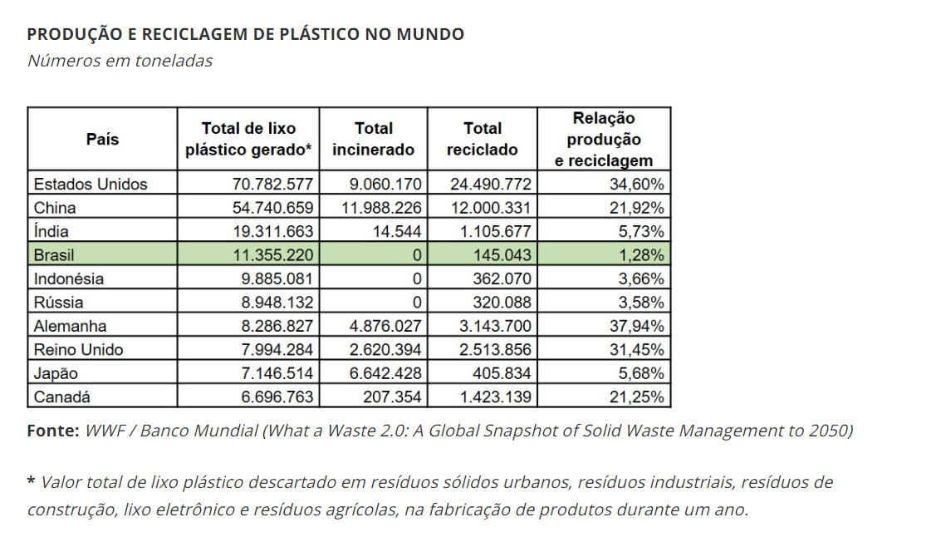
Recycling stats in Brazil vary by source
1.3% recycled
WWF: https://www.wwf.org.br/?70222/Brasil-e-o-4-pais-do-mundo-que-mais-gera-lixo-plastico

Slide 3
Recycling stats in Brazil vary by source
Plastic flow chart from Abiplast – claims that 23% of plastics are recycled
23% recycled
ABIPLAST - Associação Brasileira da Indústria do Plástico
http://www.abiplast.org.br/noticias/estudo-aponta-que-231-dos-residuos-plasticos-pos-consumo-foram-reciclados-em-2020-no-brasil/

Slide 4
Regulations on single-use plastics are increasing worldwide
Plot of single-use regulations over time
Number of new regulations on single-use plastics (bags, styrofoam, utensils, etc.)
Year
United Nations Report: Single Use Plastics, a Roadmap for Sustainability. 2018.

Slide 5
Types of policy tools
Policy tools |  | Features
Regulatory | Ban | Prohibition of a particule type or combination of single-use plastics. May be total or partial.
Economic | Levy on suppliers | Fee paid by producers or importers of a specific material (such as plastic bags), ideally passed on to retailers to generate change in consumer demand.
 | Levy on retailers | Fee paid by retailer when purchasing plastic product.
 | Levy on consumers | Charge per plastic product sold at the point of sale; standard price defined by law.
United Nations Report: Single Use Plastics, a Roadmap for Sustainability. 2018.
Notes:
EU banned single use plastics, ozone layer

Slide 6
Regulations in Brazilian cities
City | Year | Type | Features
Rio de Janeiro | 2009 | Levy | Requirement to substitute PE and PP bags with alternatives. If not done, collect plastic bags for recycling, give public discount if they bring their own bag, or pay with food products for every 50 bags collected. Impact: 24% reduction of plastic bag use
Sao Paulo | 2015 | Ban | Ban on non-biodegradable plastic bags in Sao Paulo.
United Nations Report: Single Use Plastics, a Roadmap for Sustainability. 2018.

Slide 7
Braskem aims to be carbon neutral by 2050
Graphic from Braskem on their carbon neutrality plan
https://www.braskem.com.br/portal/Principal/carbon-neutral/files/Manifesto_BRASKEM_pt-br.pdf

Slide 8
Sources
SINGLE-USE PLASTICS - Wedocs.unep.org.
https://wedocs.unep.org
https://ourworldindata.org/plastic-pollution#how-do-we-dispose-of-our-plastic

